Slide 1
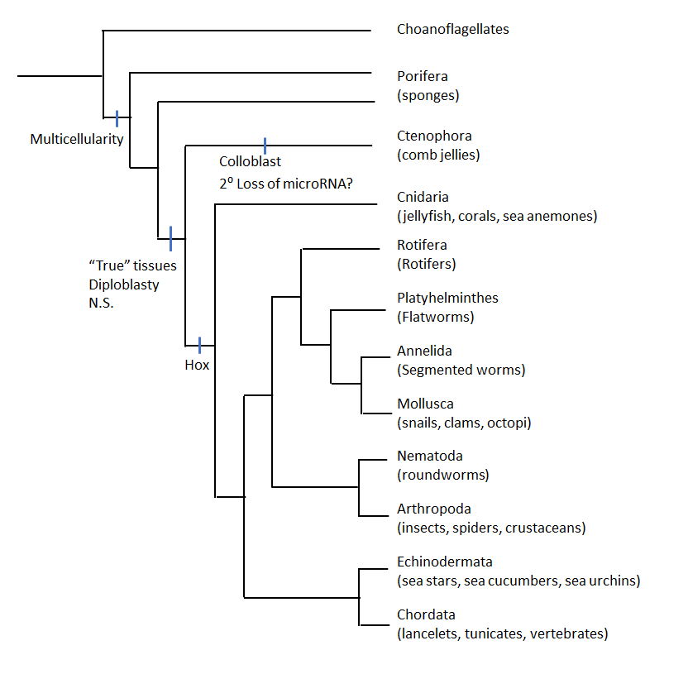
Animal Systems II
Notes:
Welcome to your round two, learning about animal systems! As you can see from this image we move from more simplistic to complex animals as we shift towards the right. Most animals are separated via phyla based on characteristics such as tissue types, symmetry, presence or absence of coelom, exo versus endo skeleton, segmentation and the presence or absence of a vertebrate. In lecture you will have already seen much of this information and for the purposes of lab we are going to start to look more at the differences in the various systems of some of these animals. The main systems we will be looking at are the circulatory, respiratory, excretory, digestion and reproduction. For the next two labs we are going to look at two phyla; Echinodermata and Chordata. You will have an opportunity to not only see some representatives in lab but do some dissections but first we have to start with some background. So let’s get started!

Slide 2
Notes:
Echinoderms are a phylum of marine invertebrates that include seastars, brittle stars, sea cucumbers, sea urchins, sand dollars, and crinoids. This group is a fairly diverse group of marine invertebrates and play an important ecological role in the oceans. These animals are characterized by their radial symmetry, a mesodermal skeleton made up of calcareous plates or ossicles which may be fused or articulated depending on the species. One of the unique features of this group is the presence of the water vascular system which is a network of fluid-filled canals derived from the coelom that is involved in gas exchange (discussed in more detail later). There are approximately 7,000 living species.

Slide 3
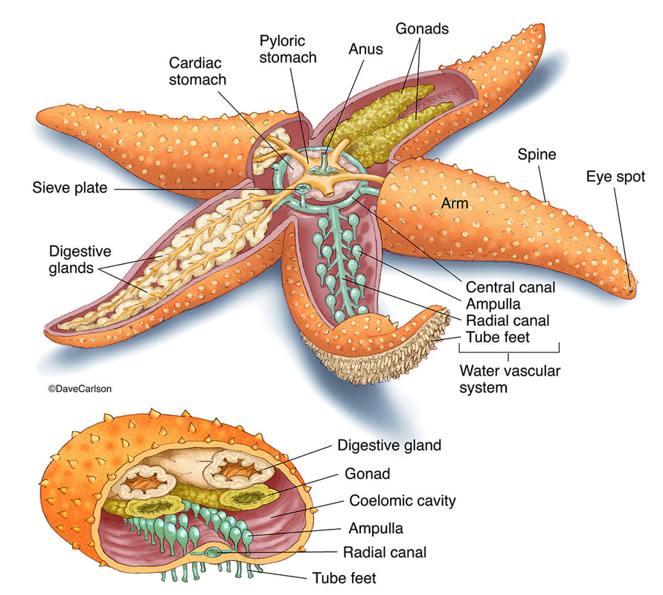
Phylum Echinodermata: Digestion
Sea Star Digestion is done by everting part of the digestive tract.
https://www.carlsonstockart.com/photo/starfish-sea-satar-echinoderm-anatomy-structure-illustration/
Notes:
Echinoderms have a simple digestive system with a mouth, esophagus, two stomachs, an intestine, rectum and an anus thus they have a complete digestive system. Many of the species have their mouth located on the underside of the body with the anus on the top. Seastars push their stomachs outside the body and insert it into the prey resulting in external digestion. Some species are suspension feeders in which they spread their arms to catch floating particulates which are caught via the tube feet and transported to the mouth through the use of the ambulacral grooves and cilia. Often when feeding on Mollusca, the seastar will create a small gap in the mollusk with its tube feet and inject part of its stomach into the prey to excrete digestive enzymes which will slowly liquify the soft body parts. This is different than what we typically see in our other organisms where we have internal digestion.

Slide 4
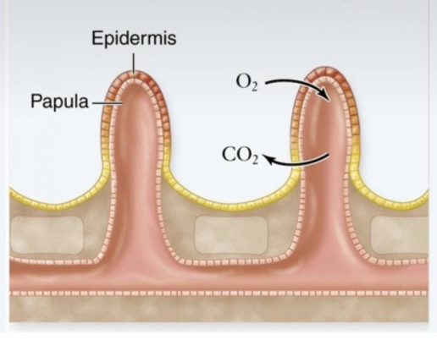
Phylum Echinodermata: Respiration
https://schoolbag.info/biology/concepts/161.html
Notes:
Simple diffusion is the name of the game for respiration. Using gills or other specialized projections, such as tube feet or pockets, water and oxygen is circulated through the body. The water vascular system is a significant component of the respiratory system as it helps carries oxygen throughout the body. Overall this group has a very poorly developed respiratory system. However as these guys are generally not highly metabolic the oxygen need is not overly high compared to some of the other organisms we have looked at.

Slide 5
Phylum Echinodermata: Circulatory
Notes:
The water vascular system provides the appropriate water pressure that operates the seastars tube feet. From the madreporite (sieve plate), water moves into the ring canal, then into the rays through the radial canal (the ambulacral ridges), and finally to the tube feet. The canals are like a network of water pipes attached to the tube feet. Changes in water pressure allow the movement of the seastar. Water will also exit the madreporte (sieve plate). Obviously we don’t have a heart(s) or organ that is responsible for pumping blood but instead this organism uses water pressure to create the movements it needs for the various systems. Thus these organisms possess an open and reduced circulatory system, though some argue that they have no circulatory system as we are not dealing with blood but rather water. For the purposes of this lab we will view a circulatory system as something which results in the circulation of any fluid within the body of the organism.

Slide 6
Phylum Echinodermata: Excretion
Notes:
Digestive waste is released as feces through the anus. Other cellular wastes will be passed directly into the water through the tube feet, and/or gills via diffusion. There is no defined excretory organ and thus this is a fairly simplistic “system”. In part, this because echinoderms do not need to try and regulate their internal system as they are osmoconformers (meaning they maintain osmoregularity with their outside environment)

Slide 7
Phylum Echinodermata: Reproduction
Larval stage will be highly variable depending on the organism but is usually bilateral.
https://www.toppr.com/content/story/amp/asexual-reproduction-fragmentation-16633/
Notes:
Echinoderms are sexually dimorphic (have female and male and release their eggs and sperm cells into water where fertilization takes place externally. Remember this is like what we saw in the clams and the grasshopper). The release of sperm and eggs is synchronized in some species, based on the lunar cycle. In other species individuals may aggregate during the reproductive season thus increasing the chances of fertilization. The echinoderm begins with a bilaterally symmetrical embryo and will continue developing through various stages of larva until reaching its adult form. The name of these various larval stages vary depending on the type of echinoderm.

Slide 8
Phylum Echinodermata: Summary
Complete
Digestive
System
Excretion –
Solid Waste
(anus)
Otherwise
Dermis
Open
Circulatory
System (Water Based)
Reproduction –
External
Fertilization
Respiration
via
Diffusion

Slide 9
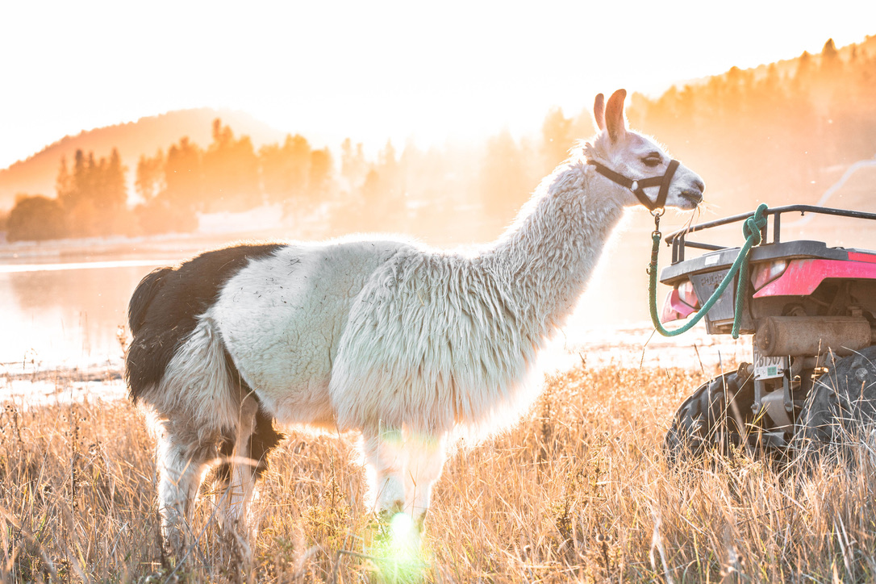
Welcome
to
Vertebrates

Slide 10
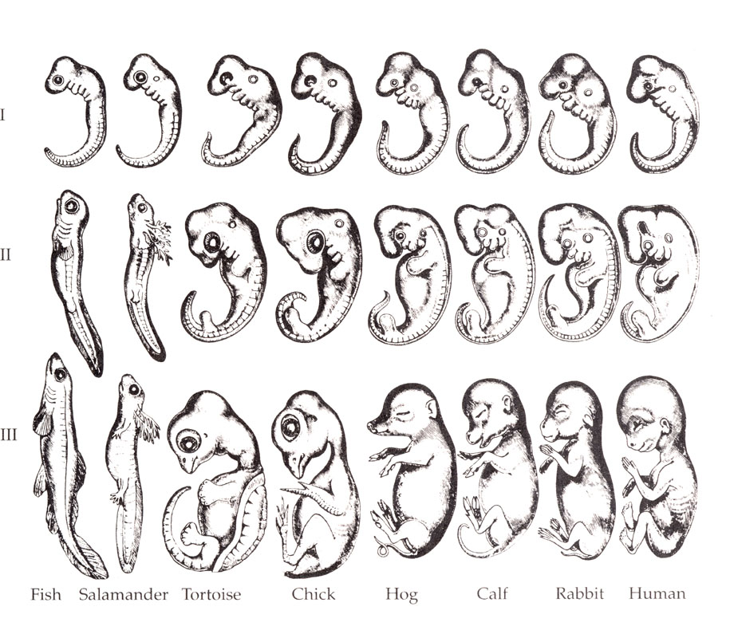
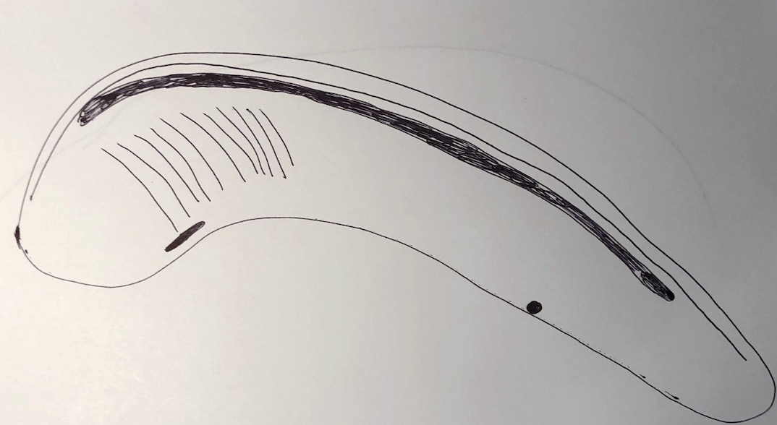
Chordates
Chordates include,
Invertebrate Chordates and Vertebrates
5 Main Traits are Common Among All Chordates for At Least a Portion of Life
Top
Dorsal Hollow Nerve Cord
Head
Notochord
Tail
Pharyngeal Slits
Endostyle
Post Anal Tail
Anus
Bottom
Notes:
These characteristics define the chordate group. Chordates are so diverse that the question is what unites them all. Well, it turns out that they all have these 5 features at some point during their development: Post anal tail, dorsal hollow nerve cord, notochord, endostyle and pharyngeal slits.
Post anal tail – a tail behind the anus
Dorsal hollow nerve cord – a nerve cord that runs the length of the body along the top and is homologous with the brain and spinal cord
Notochord – stiffened cartilaginous rod between the bottom and the dorsal hollow nerve cord
Endostyle – mucus secreting structure on the ventral (bottom) side. Mucus is sometimes iodine rich – homologous with thyroid
Pharyngeal slits – slits in the pharynx (neck) region that are used in respiration and feeding

Slide 11
Phylum Chordata: The Perch
Freshwater
Perch
Torpedo Shape
Bony scales
Spring Spawning
Light Coloured Belly
15 inches, 2.2lbs
Swim Bladder
Notes:
The Perch is part of the genus Perca and is a freshwater gamefish. You can find these guys in fresh water such as lakes, ponds, rivers and streams. They spawn in the springtime laying strings of eggs among water plants and branches. They are typically around 15 inches in length and roughly 2.2 lbs. They have slimy skin which helps to prevent them from being grasped easily. They also have a lightly coloured belly which gives predators a hard time to see them from below. They have a stocky, torpedo shaped body for quick takeoff and a swim bladder containing gas which helps prevent fish from sinking or floating in the water.

Slide 12
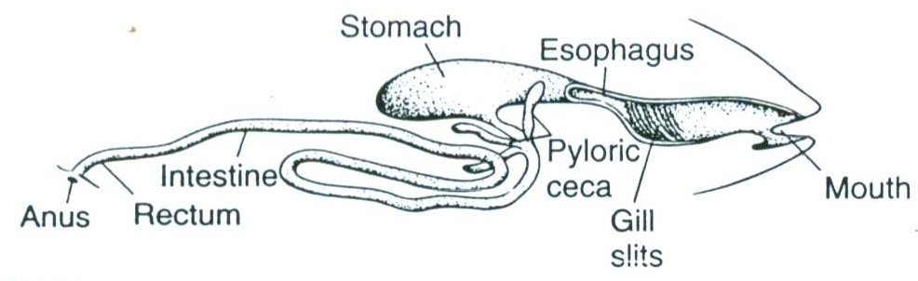
Phylum Chordata: Perch Digestion
Complete Digestive System
Rakers = Filter Food
Palatine = Rip Food
https://www.carlsonstockart.com/photo/mollusk-clam-anatomy-structure-illustration/
https://www.researchgate.net/publication/265754079_A_Revision_of_Irvine%27s_Marine_Fishes_of_Tropical_West_Africa/figures?lo=1&utm_source=google&utm_medium=organic
Notes:
The perch is considered a carnivore and typically feeds on smaller fish, shellfish and insect larvae. They have specialized teeth (palatines) used to eat small fish and gill rakers, which are small filters in the gills, used to ingest and filter zooplankton. Food enters via the mouth and is ripped up with the teeth, The food then enters the stomach for digestion. The pyloric ceca are finger liked pouches that absorb nutrients and secrete digestive enzymes and the liver and pancreas help to break down fats and chemicals via secreted digestive enzymes. The intestine runs from the ceca and leads to the anus. Here most of the food absorption is done via the intestine though it starts in the ceca. Thus this organism has a complete digestive system.

Slide 13
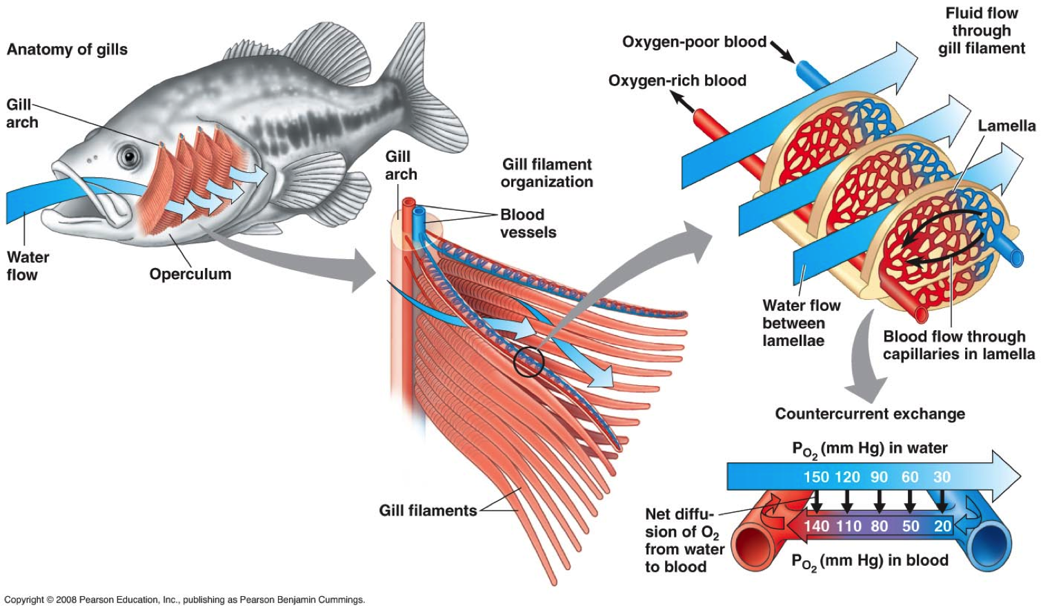
Phylum Chordata: Perch Respiration
Gill Arch
Capillary Beds = Gas Exchange
Operculum
Counter-Current Flow
Gill Chamber and Four Gills
Notes:
Perch use their mouths, not their nostrils to gulp oxygen-rich water over their gills and then the oxygen-poor water gets pushed out by the gills through openings in the side of their head. The opening is covered by the operculum. Upon removing the operculum you see the gill chamber and four gills. The hard bony support is the gill arch with posteriorly directed gill filaments. The hard-anterior finger-like projections, the gill rakers, prevent coarse material or food from passing through the gill slits. The gill filaments are supplied with capillary beds across which gas exchange occurs. Blood flow is opposite to the flow of water across the gills creating a counter-current. This counter-current flow increases the rate of diffusion to efficiently extract oxygen from relatively poorly oxygenated water. In order to be able to respire in this way this animal has a closed circulatory system which allows the maintenance of higher blood pressure which allows for quicker movement throughout the body. This is significantly different than what we saw in our grasshopper friend.

Slide 14
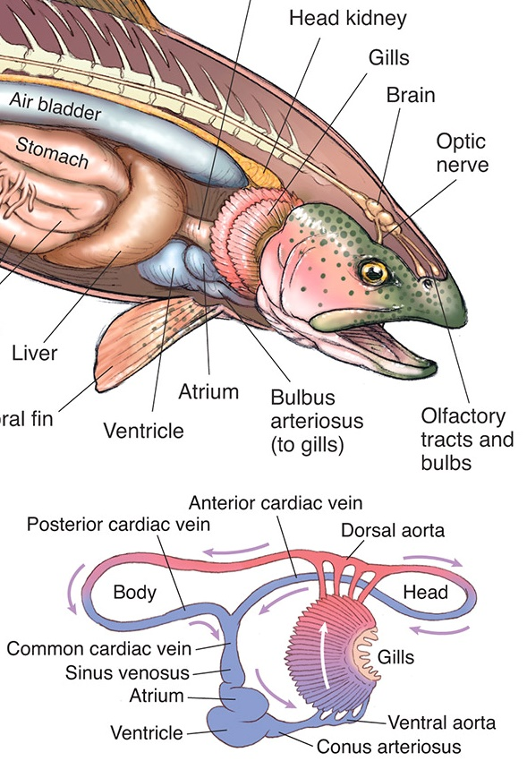
Phylum Chordata: Perch Circulation
Closed Circulatory System – Increase Pressure and Efficiency
Single Circuit: Heart – Gills – Body - Heart
Fish –
2 Chambers Heart – Mammals 4 Chamber Heart
Pressure Drops In Fish Capillaries but Mammals Maintain Blood Pressure (More Efficient)
https://www.carlsonstockart.com/product/prints/173/
Notes:
The pericardial cavity, found just below and on the ventral side of the gills, contains two-chambered heart. This is a simple organ that pumps blood for animals with gills and single circulatory direction. Essentially the formation of the heart is simply a thickening of the circulatory system. In the perch we see a thin-walled posterior atrium extending over the thicker-walled ventricle. Anterior to the ventricle is the bulbus arteriosus, the enlarged base of the ventral aorta that carries blood to the gills and the rest of the body. Blood is under pressure when it reaches the gills, but pressure is reduced when the blood passes through the capillary bed. It will remain low as the blood travels to the rest of the body. This is different then what we see with other animals with a pulmonary loop, where blood travels back from the lungs to the heart, is then pumped to the rest of the body, allowing it to service body tissues more efficiently than the lower pressure system. You can see the different in hear formation in the diagram provided. We see the development of a 4 chambered heart as we move into mammals.

Slide 15
Phylum Chordata: Perch Excretion
Seastar – No Organ
Grasshopper – Malpighian Tubules
Perch - Kidneys
https://mpg.printstoreonline.com/medical-illustrations/illustration-excretory-fish-8251483.html
http://circulatory-excretory-annika.weebly.com/excretory-system.html
Kidneys = Excretion of Waste
&
Osmoregulation
Notes:
The main organs involved in the excretory system of the perch are the kidneys, urinary bladder, and urogenital pore. The kidneys in the perch excrete large amounts of dilute urine in order to rid the body of excess water. In fish the excretory system, in particular the kidneys, are also involved in maintaining homeostasis (balance between its internal environment and its external) in an environment where osmosis is a concern. Remembering from last term, osmosis, tends to promote the loss of water from the body of a marine fish and the absorption of water in a freshwater fish. In freshwater fish the kidney’s tend to excrete large amounts of water which helps to counteract the water absorbed through the skin. They also tend to lose salt to the environment and thus must replace it. They do this via their food, but the gills and skin inside the mouth will actively absorbed salt from water passed through the mouth via diffusion. We have seen animals with hardly any type of organ involved in excretion like the seastar to those with simpler excretory organs such as the Malpighian tubules in the grasshopper.

Slide 16
Phylum Chordata Perch Reproduction
Notes:
Perch will be either male or female. When a female perch is ready to mate, a group of males will surround her. She releases her eggs into the water and they stick to the bottom. All the males then release their sperm at the same time, so the eggs can be fertilized by different fathers. So here we have external fertilization like we have seen in the molluscs and echinoderms. After spawning, adults migrate back downstream. Eggs hatch to create the larva which will grow into the juvenile and finally the adult phase. Females mature between 2 to 4 years old, while males mature about one year earlier. This is much different than what we see in humans ;).

Slide 17
Phylum Chordata: Perch Summary
Closed Circulatory System – Single Circuit
Complete Digestive System
Unidirectional Respiration – Counter-current
Kidneys! Excretion and Osmoregulation
Reproduction– External Fertilization

Slide 18
Phylum Chordata – All About Rats
Notes:
Rats are various in size, have long tails and are found in the genus Rattus (the “true rat”). The tail of the rat has three primary functions; thermoregulation, balance and defense (the outer layer will shed to escape from a predator). Some species are bred as pets since the late 19th century. These rats can be very friendly and trained. Rats are also used in scientific research and education as you will see when you dissect them next week. The intelligence of rats has been deemed high based on its ability to learn. Rats are also used as “working rats” where they are responsible for sniffing out gunpowder residue, demining (removing land mines), acting and animal-assisted therapy. Rats have the ability to swim up sewer pipes into toilets and will reside in any location which provides shelter and with easy access to food and water. Rats have been found in nearly all areas of the globe.

Slide 19
Phylum Chordata: Rat Digestion
https://i.pinimg.com/originals/03/ca/fd/03cafdb67cca5e9b160f94e6b560fc9f.jpg
Notes:
Just like us food enters the mouth/Buccal cavity to begin ingesting food. The food is then mashed up so that it can be easily swallowed. Next the salivary glands produce saliva which helps to moisten food. Within the saliva there are enzymes which help to further breakdown food. After the food has been mashed in the mouth it heads to the pharynx. The pharynx serves as a chamber to hold the food before heading into the oesophagus. The oesophagus is a long muscular tube which transports food into the stomach for digestion. The stomach is a muscular sac that further breaks down food. Here you find gastric glands within the inner lining of the stomach which will produce gastric juices that helps to breakdown food. This what creates the acidity in the stomach. The pyloric sphincter separates the stomach and the small intestine. The function of this structure is essentially to act as a gate keeper between the stomach and the intestine. It will open once the food is ready to go. The small intestine receives the food and starts to absorb the nutrients. There are three parts here including the duodenum, the ileum, and the jejunum. Within this structure we have intestinal glands which secrete alkaline enzymatic juices, intestinal juices, and mucous to help absorb and digest the nutrients. Next we have the large intestine also referred to as the colon. This is the last stage of digestion when the water is absorbed. Within the colon there are bacteria to help. The caecum is the structure where the small intestine becomes the large intestine. It’s a small pouch similar to the appendix where cellulose is digested. As we make our way out of the digestive system we have the rectum which holds waste (feces) until they are ready to be expelled by the anus. Often the spleen is considered part of the digestive system as it is responsible for destroying old red blood cells. The liver is also involved as it secretes bile into the intestines which helps to digest cholesterol.

Slide 20
Phylum Chordata: Rat Respiration
Take a closer look
And closer
https://www.sciencedirect.com/science/article/pii/B9780128029008000099
Notes:
Air flows past the larynx down the trachea. The trachea brings the air to the bronchi which branch into two bronchioles then divided into finer and finer branches leading to tiny blind-ended sacs called alveoli within the lungs. The alveoli are responsible for increasing surface area for gas exchange. An interesting fact about rats is that when they are needing to squish themselves into a tiny space they flatten out and extend the trachea by 50% without any decrease in the diameter of the airway which results in the neck being extended. Of course humans can’t do that but otherwise our systems are pretty similar. Guess we can’t all be as cool as rats. On another pretty neat adaptation, rats have the ability to absorb oxygen through their intestines during low-oxygen-use times of hibernation. This is due to the intricate mesh of tiny blood vessels just below the surface of the rectum which allows the exchange of oxygen. Although you aren’t likely to see this butt breathing from your pet rat its just another way they can respire. Kinda seems like humans a little less exciting now yes?

Slide 21
Phylum Chordata: Rat Circulation
Oxygen to Body
Oxygen Poor Blood From Body In Here
To Lungs
From Lungs
Oxygen Poor Blood From body In Here
Notes:
The heart of the rat is really small and so it would be really hard to see all the associated structures in a dissection. Blood from the posterior portion of the body will enter the right atrium of the heart through the inferior vena cava and the superior vena cava. The blood flows from the right atrium to the right ventricle via the tricuspid valve. Blood is then pumped through the pulmonary semilunar valve and into the pulmonary trunk where blood travels to the lungs. Blood then flows through the pulmonary arteries to the lungs where it is oxygenated and then returns from the lungs to enter the left atrium via four pulmonary veins. Next blood goes from the left atrium to the left ventricle via the bicuspid (or mitral) valve. The blood then leaves the left ventricle of the heart through the aortic semilunar valve and enters the aorta. The aorta has a visible arch with vessels that lead to the head before the artery descends into the rat’s thoracic cavity.

Slide 22
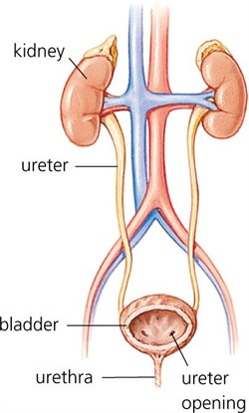
Phylum Chordata: Rat Excretion
Urine leaves Kidney through Ureters
Human Kidney
Urine passes from Ureter to the Bladder
Urine leaves the Bladder through the Urethra
Rat Kidney
https://surgery.ucsf.edu/conditions--procedures/glomerular-diseases.aspx
Notes:
The primary organs of the excretory system of the rat are the kidneys. These large bean shaped structures are located toward the back of the abdominal cavity on either side of the spine. Renal arteries and veins supply the kidney’s with blood. The structure and function of the kidney is the same as in humans. Both have renal arteries, renal veins and ureters. The ureter will carry urine from the kidneys to the urinary bladder (a muscular sac in the lower belly). During urination, the urine exits the bladder and leaves the body via the urethra, another tube like structure.

Slide 23
Phylum Chordata: Rat Reproduction
http://ldiagrams.oliovinoturismo.it/diagram/female-rat-reproductive-system-diagram
Notes:
The male rat will release sperm from the epididymis which will travel through the vas deferens to the urogenital duct (basically the end of the penis). Of course nothing happens unless the male releases the sperm into the female rats via the vaginal opening. The gonads of the female rate are paired ovaries. The ovaries release egg cells into the oviducts. During ovulation, oviducts attached to the ovaries receive the mature eggs. In the presence of sperm, fertilization usually occurs in the upper third of the oviduct. This is followed by implantation farther along in the system, in one of the uterine horns. The length and shape of each uterine horn allows several fetuses to develop simultaneously. In rats, the vagina is formed from the union of the uterine horns. The external opening of the vagina is the vulva; this opening is separate from the urethral orifice through which urine is excreted.

Slide 24
Complete
Digestive
System
Closed
Circulatory
System
Bidirectional
Respiration
Excretion –
Filters &
Absorbs
Reproduction
= Human with
More babies
Notes:
Complete Digestive System, Closed Circulatory System, Bidirectional Respiration, Excretory System – filters and reabsorbs

Slide 25
Well that was
a lot of information.
Any questions?

